Slide 1
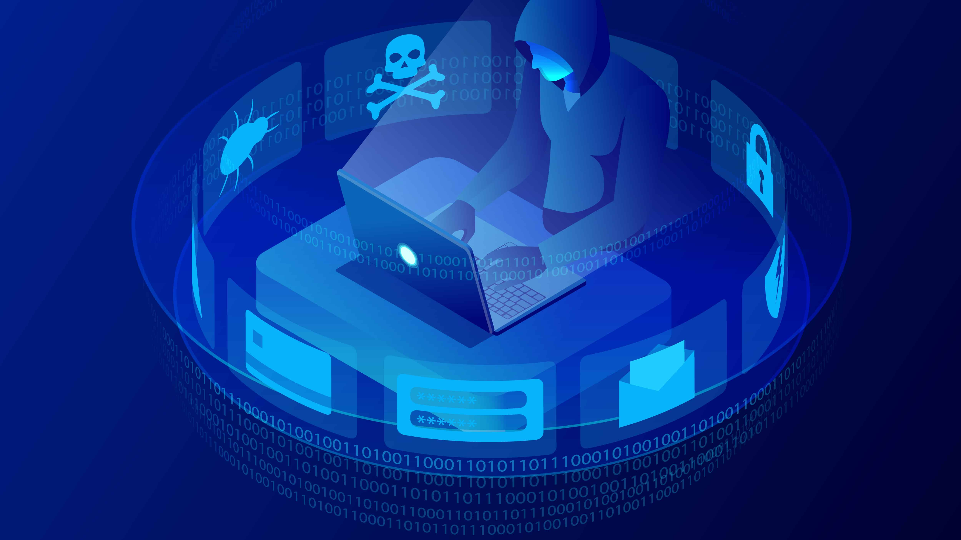
New England Hospital Security Report
OCEAN GRAHAM Student ID: 15228802

Slide 2
Things explored
An assessment of the New England Hospital overviewing:
Why Security is needed?
Industry Standards
Hospital IT Infrastructure
Vulnerabilities Identified
Mitigation strategies
Cloud Computing
Legal and Social Repercussions

Slide 3
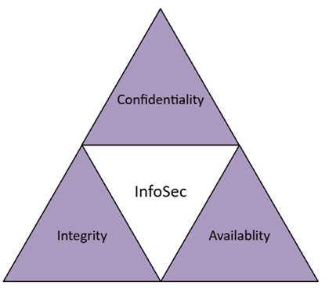
Why Security is Needed?
Prime target for attacks due to value and importance
Keep data secure
Reduce Risk of security breaches
Mitigate and remediate damage in cases of breach
Maintain the principles of CIA
Notes:
INFO SEC DEFINITION – The protection of both physical and digital info against unauthorised access

Slide 4
Industry Standards
ISO/IEC 27001
- Provides guidance for improving ISMS
- Provides a centralised framework
- Provides certification
NIST SP 800/30
- Alternative to ISO/IEC 27001
- Provides a Risk assessment guideline

Slide 5
Hospital IT Infrastructure
Workstations using Windows 8 or 10
Servers working on Windows 2016, 2019
Legacy Windows XP systems
Online Web Services via Internet to access records
Linux based SQL servers
J2EE Java Glass Fish application servers
Active directories, web servers, SQL databases

Slide 6
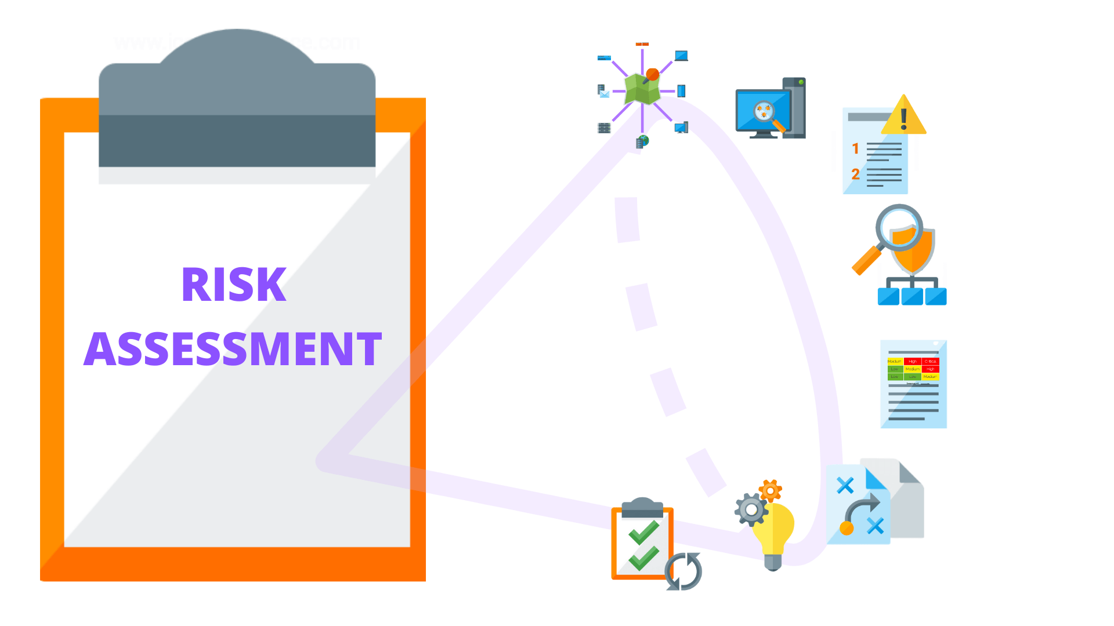
Risk Assessments
Risk assessment was developed via online research on vulnerabilities within systems using CVE
Data was laid out in tables
Use of Penetration testing to further identify and confirm vulnerabilities within the systems

Slide 7
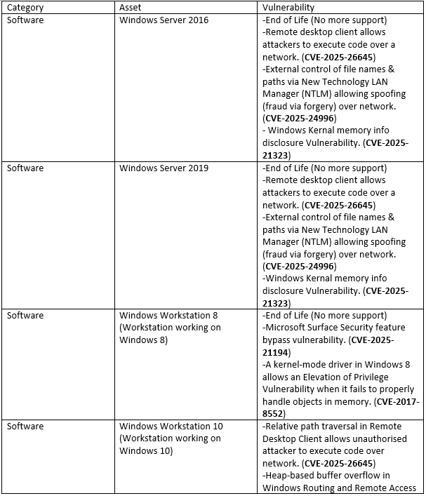
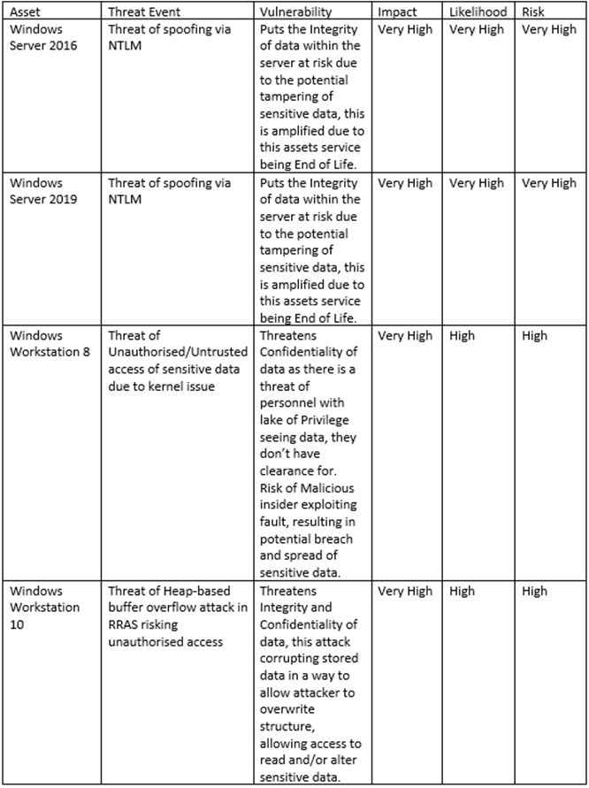
Identified Issues and Threats
End of Life
Spoofing
DoS/DDoS
SQL Injections
Phishing
Escalation of Privileges
Outdated Hardware
Man-In-The-Middle

Slide 8
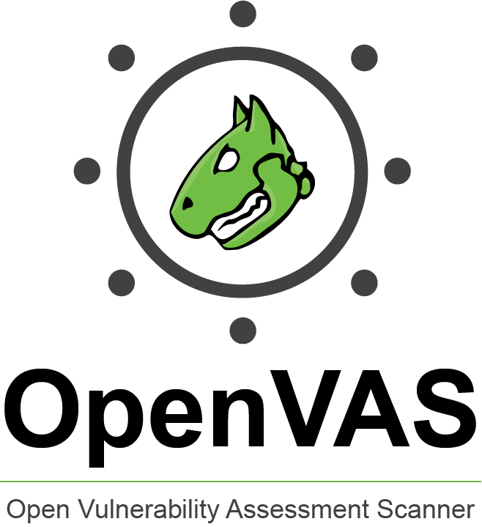
Penetration Testing
Kali Linux
nMap & Metasploit
TheHarvester
ShellPhish
SQL Map
OpenVAS performs vulnerability scans and makes reports

Slide 9
Mitigation Strategies
Upgrade to New Systems
- e.g. Windows Server 2022 and Windows 11
- Have better security protection and features to mitigate threats
- Can help resolve and mitigate risks relating to End of Life and Legacy
Implement Firewalls
- Protect network against unauthorised access via controlling network traffic
- Protects against SQL Injection, Heap-based Buffer overflow, Malware, DoS/DDoS, Brute-force attack

Slide 10
Mitigation Strategies
Implement Two Factor Authentication / External Approval System
- Access requires two levels of identification
- Protects against Phishing, Brute-force attack, Keylogging
Improve Security and Access Control
- Restricting access to resources via regulating who can view resources based on clearance/role
- Protects against Unauthorised access, Privilege escalation, Brute-force attack, Phishing

Slide 11
Mitigation Strategies
Implement Encryption
- Converting plaintext into ciphered text which makes it unreadable without the decryption key
- Protects against Brute-force attacks, Phishing, Man-in-the-Middle, SQL Injection, DoS/DDoS
Implement Network Segmentation
- Divides network into smaller isolated networks
- Limits damage by restricting damage to only the breached segment

Slide 12

Cloud Computing
What is Cloud Computing?
Advantages of Cloud Computing?
Flexibility & Efficiency
Inbuilt Security and security expert personnel in provider organisation
Disadvantages of Cloud Computing
Reliant on internet connectivity
Expensive upfront investment and maintenance

Slide 13

Cloud Computing
3 Main Cloud Platform Providers:
Amazon Web Services (AWS)
Offers a wide scale of security services such as encryption Monitoring and Logging
Microsoft Azure
Provides a wide scale of security tools similar to AWS but also provides tools such as Identity and Access Management (IAM)
Google Cloud Platform (GCP)
Specialises in data encryption and analytics

Slide 14

Cloud Computing - Migration
1) Rehost – Moving data as is
2) Refactor – Move with small changes to fit the cloud
3) Replatform – Move with upgrades
4) Rebuild – Start completely new
5) Replace – Use a cloud-based app instead
6) Retire – Remove things that are not needed

Slide 15
Legal and Social Repercussions
Legal repercussions for not following guidelines of Legislations:
- HIPAA
- GDPR
- Common Law Duty of Confidentiality
- Data Protection Act 2018
Criminal Charges
Fines
Loss of Credibility, Trust and Reputation
Danger to Patients and Staff

Slide 16
Conclusion
Security is integral factor to invest in for an organization to protect against risk
The Hospital Infrastructure holds many vulnerabilities which elevates the risk of the organisation
With the mitigation strategies identified and if applied the threat to the CIA Triangle will be limited
Cloud Computing is a valuable process to invest into for the future to protect the assets and sensitive information the hospital holds

Slide 17
References
IBM, 2024, What Is Information Security? | IBM
Kali Linux – Exploitation Tools | GeeksforGeeks
Personal data breaches: a guide | ICO
Penalties | ICO

